Slide 1
Practica - Xtext
Cheng Deng
Xtext - The Grammar Language (eclipse.org)

Slide 2
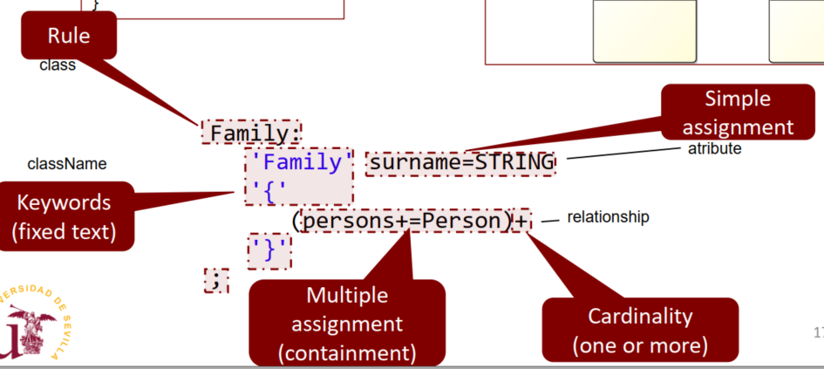
Defining the model

Slide 3
Rule grammar
RuleName:
‘Keyword’ name=Type // simple assignment for attributes
‘Keyword’ truefalse?=‘truefalse’ // simple assignment for boolean
‘Keyword’ relationName+=Type // multiple assignment for containtment
‘Keyword’ relationName+=[Type] // M.A for association
‘Keyword’ relationName+=[]
‘Keyword’ (relationName+=[Type])cardi;
Cardinality(cardi) can be
+ one or more
* zero or more
? optional
;

